Slide 1



Credit Risk Prediction
By : Jackie Limanto

Slide 2
Background

Slide 3
Problem
Credit risk is the possibility of losing a lender holds due to a risk of default on a debt that may arise from a borrower failing to make required payments.
Goal
The Goal is assess the likelihood of a borrower defaulting on their credit obligations.

Slide 4
Table of Content
Exploratory Data Analysis
Data Preprocessing
Data Modelling
Insight and Recommendation

Slide 5
Exploratory Data Analysis
Dataset has 466285 rows and 75 columns
There are feature that have null values (null values with >50% or more will be dropped)
1
2
Unique feature or column will be delete/drop
No Label on dataset
3
4

Slide 6

Labelling the Loaner
Good Loaner
Current, Fully paid, In Grace Period
Bad Loaner
Charged off, Late (31-120 days), Does Not Meet the Credit Policy, Late (16-30 days), Default.

Slide 7
Data Preparation
Check Duplicated Data
Scalling the numerical feature
Handling the outlier
1
3
5
2
4
Drop Feature that has null value >50% and unused feature
Scalling the categorical feature

Slide 8
Data Modelling

Slide 9
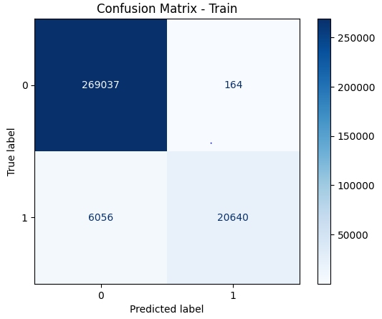
Classification Report - Train precision recall f1-score support 0 0.98 1.00 0.99 269201 1 0.99 0.77 0.87 26696 accuracy 0.98 295897 macro avg 0.99 0.89 0.93 295897 weighted avg 0.98 0.98 0.98 295897

Slide 10
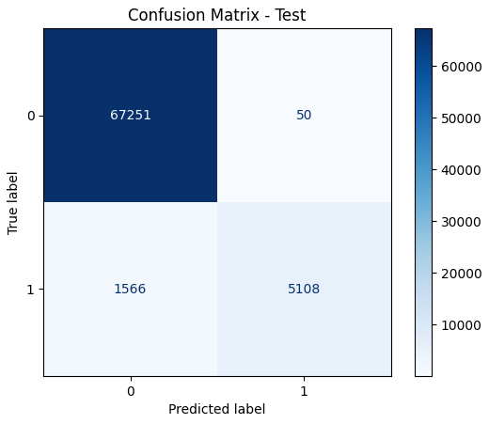
Classification Report - Test precision recall f1-score support 0 0.98 1.00 0.99 67301 1 0.99 0.77 0.86 6674 accuracy 0.98 73975 macro avg 0.98 0.88 0.93 73975 weighted avg 0.98 0.98 0.98 73975

Slide 11
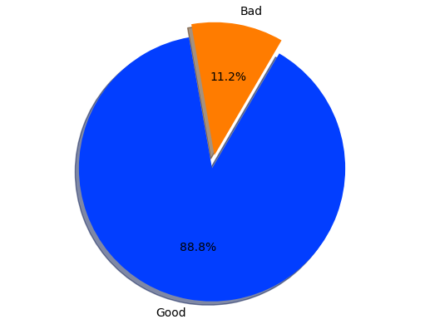
Insights
Based on Status Loaner

Slide 12
Recommendation
It is important to carefully evaluate the loaner’s creditworthiness and the potential risk associated with the loan amount. Also, ensure that the loan are viable to both parties.

Slide 13
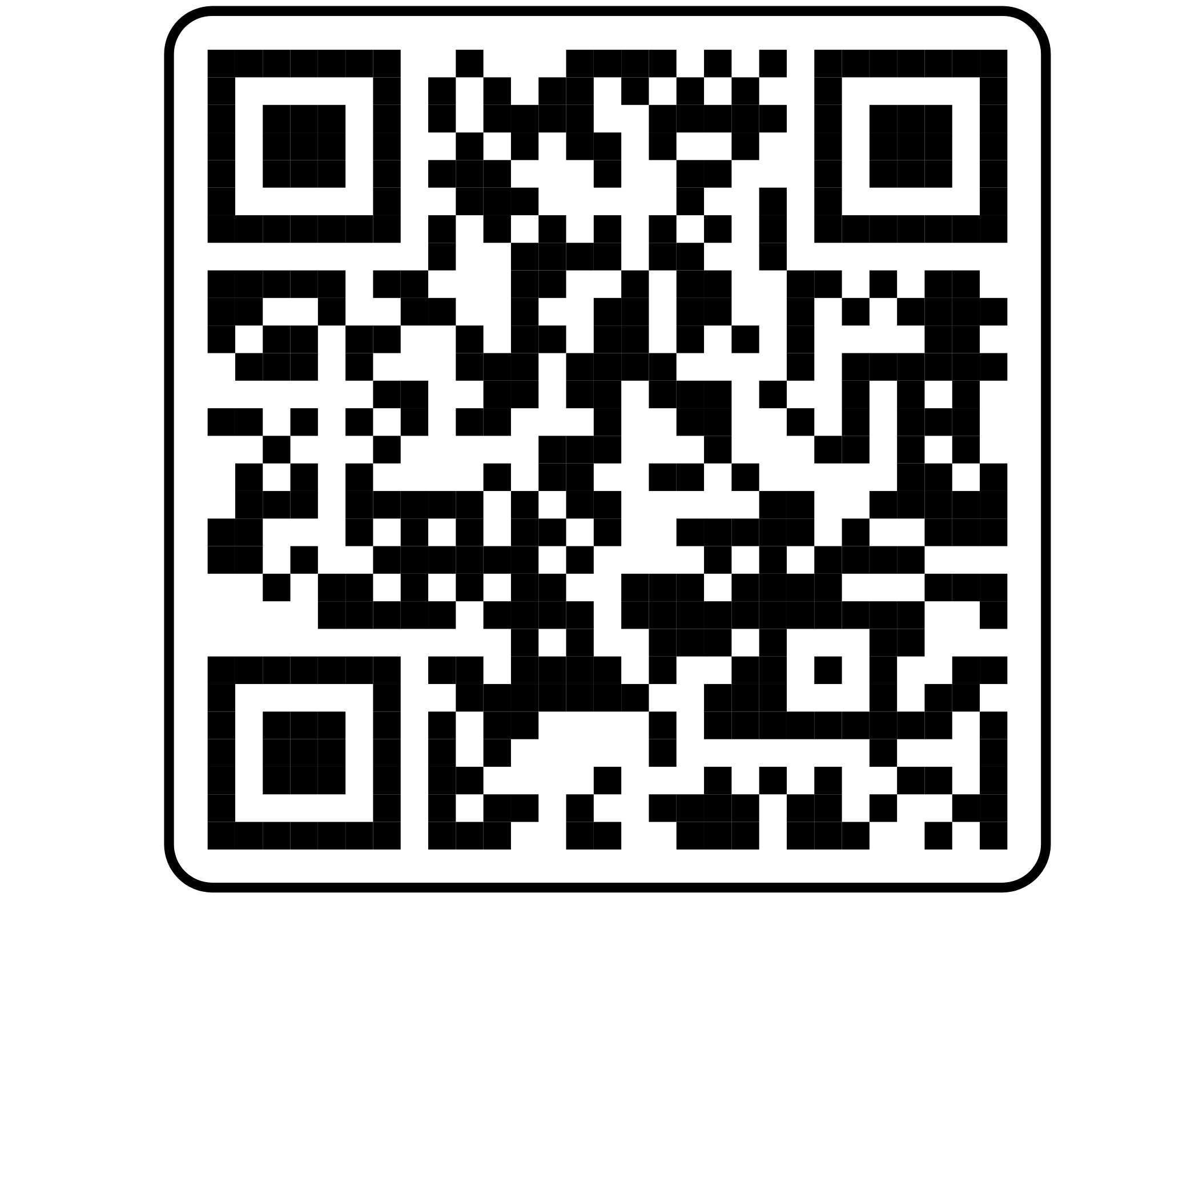
Thankyou
Any questions? You can find me at:
@jackielimanto
Jackie.limanto@gmail.com

